Slide 1

Database / DBMS

Slide 2
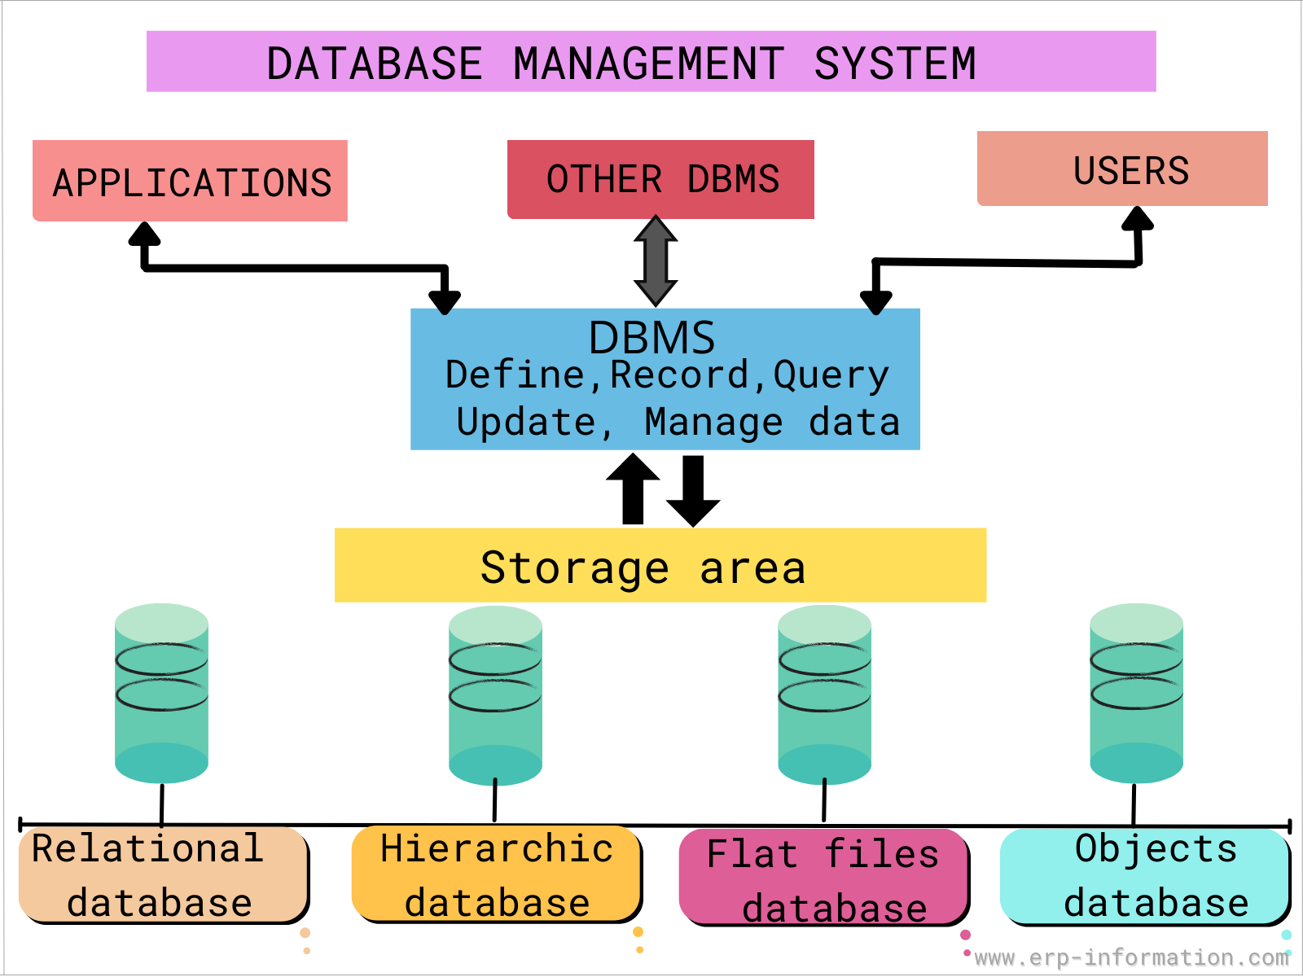
Database
A database is an organized collection of data, so that it can be easily accessed and managed.
You can organize data into tables, rows, columns, and index it to make it easier to find relevant information.
The main purpose of the database is to operate a large amount of information by storing, retrieving, and managing data.
There are many databases available like MySQL, Sybase, Oracle, MongoDB, Informix, PostgreSQL, SQL Server, etc.
Modern databases are managed by the database management system (DBMS)

Slide 3
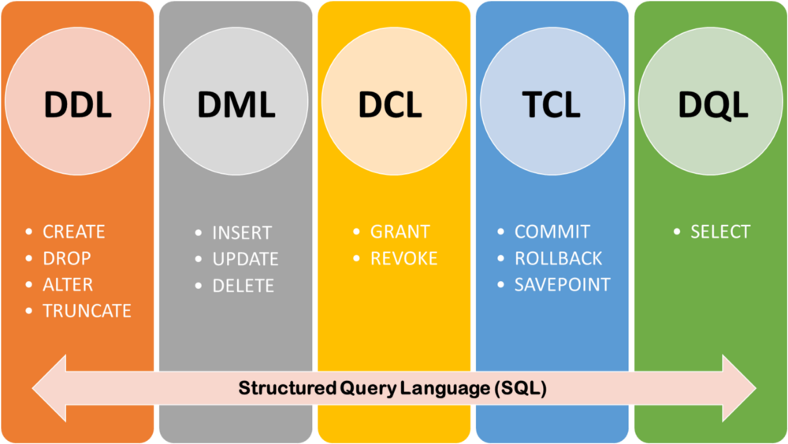
SQL
SQL (Structured Query Language) is used to perform operations on the records stored in the database, such as updating records, inserting records, deleting records, creating and modifying database tables, views, etc.
SQL is not a database system, but it is a query language
SQL Commands are ,
DDL: Data Definition Language
DML: Data Manipulation Language
DCL: Data Control Language
TCL: Transaction Control Language
DQL: Data Query Language

Slide 4
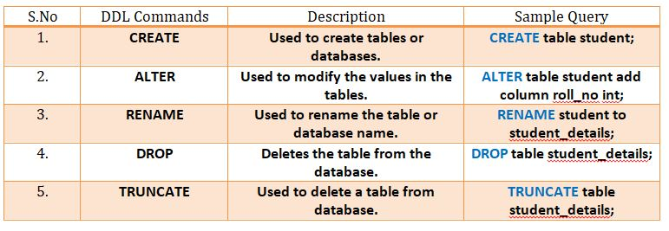
Data Definition Language
In order to make/perform changes on the physical structure of any table residing inside a database, DDL is used. These commands when executed are auto commit in nature and all the changes in the table are reflected and saved immediately.

Slide 5
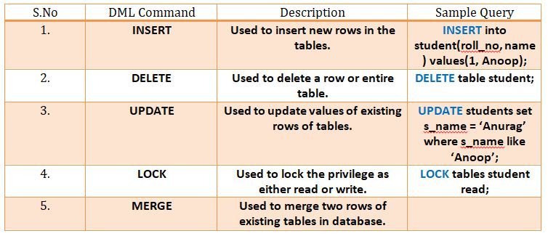
Data Manipulation Language
Once the tables are created and database is generated using DDL commands, manipulation inside those tables and databases is done using DML commands. The advantage of using DML commands is, if in case any wrong changes or values are made, they can be changes and rolled back easily.

Slide 6
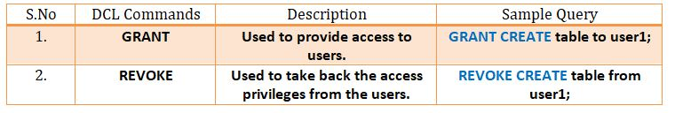
Data Control Language
DCL commands as the name suggests manages the matters and issues related to the data control in any database. DCL commands mainly provides special privilege access to users and is also used to specify the roles of users accordingly.

Slide 7
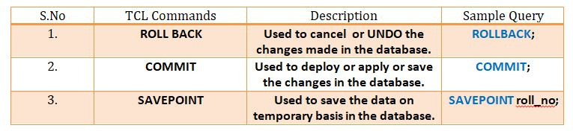
Transaction Control Language
Transaction Control Language as the name suggests manages the issues and matters related to the transactions in any database. They are used to rollback or commit the changes in the database.
Roll back means “Undo” the changes and Commit means “Applying” the changes. There are three major TCL commands.
A SAVEPOINT is a point in a transaction when you can roll the transaction back to a certain point without rolling back the entire transaction.

Slide 8
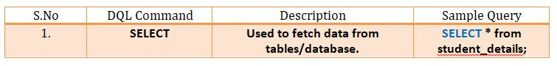
Data Query Language
Data query language consists of only one command over which data selection in SQL relies. SELECT command in combination with other SQL clauses is used to retrieve and fetch data from database/tables on the basis of certain conditions applied by user.

Slide 9
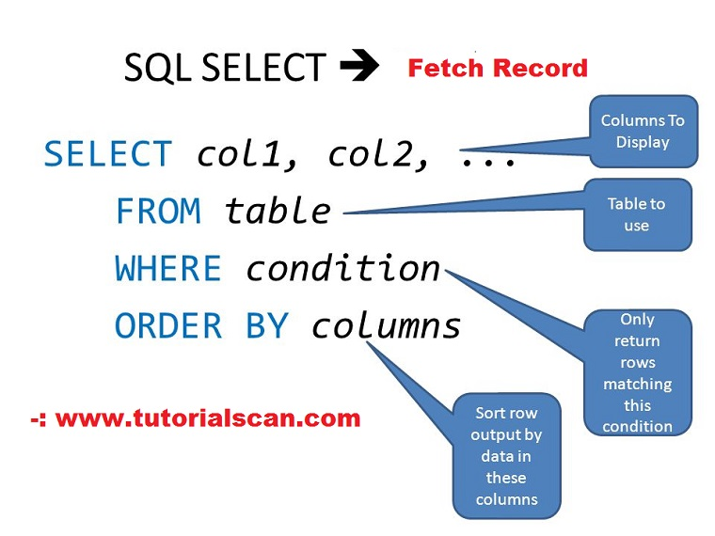
Select Query

Slide 10
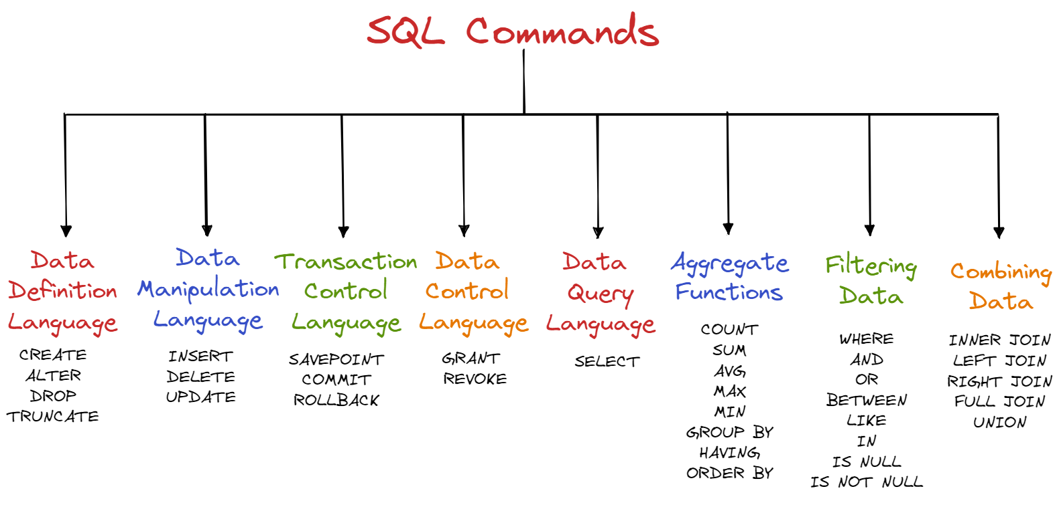

Slide 11
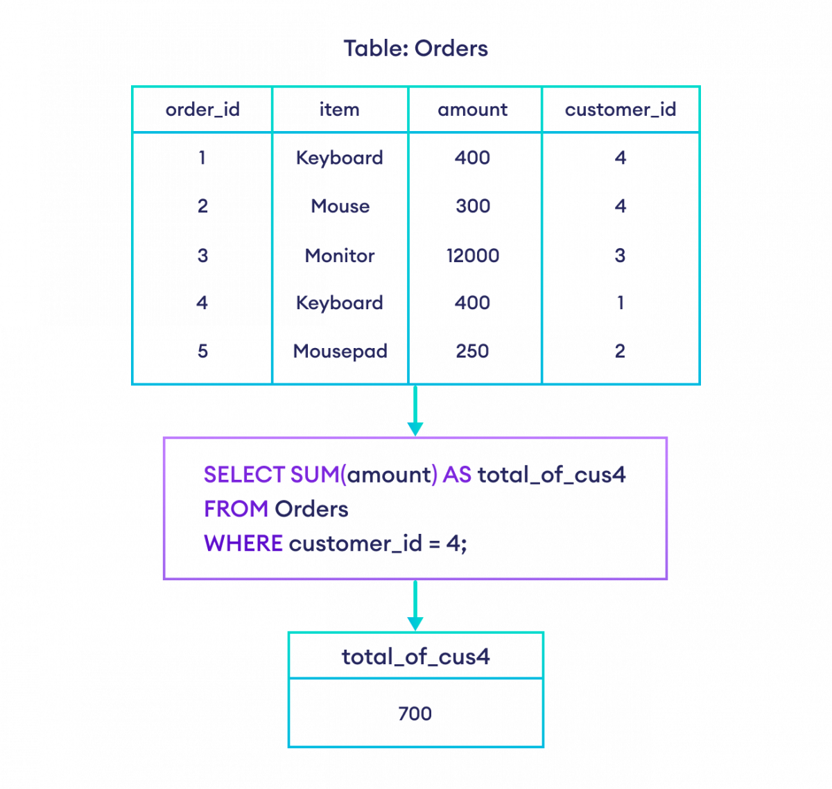
Sum() with where Clause

Slide 12
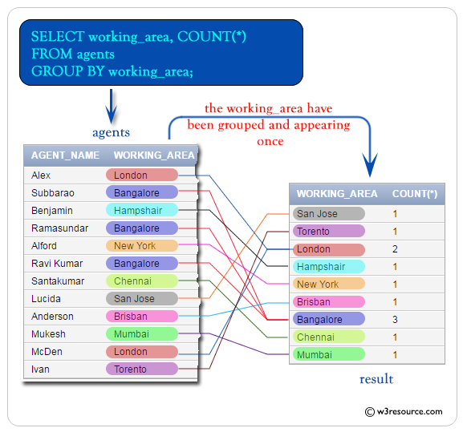
Group By

Slide 13
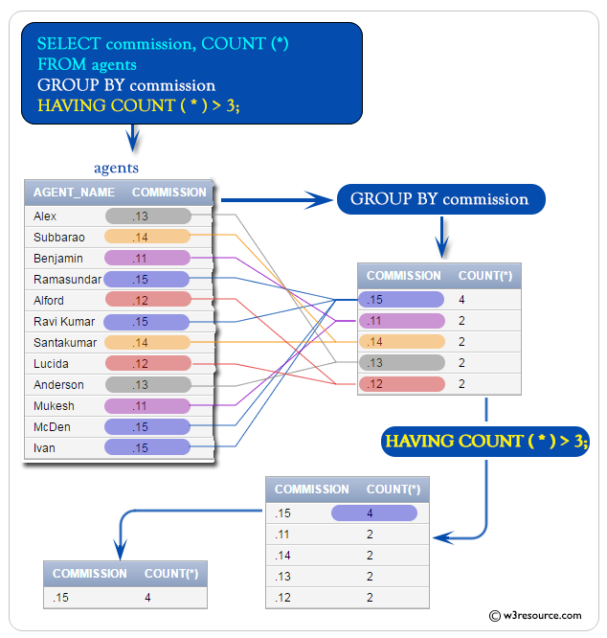
Having

Slide 14
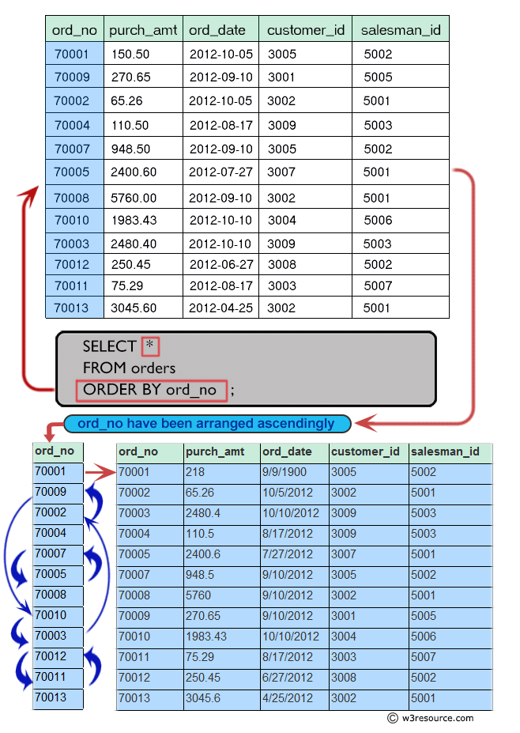
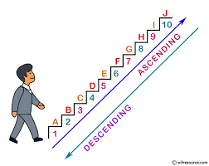
Order By

Slide 15
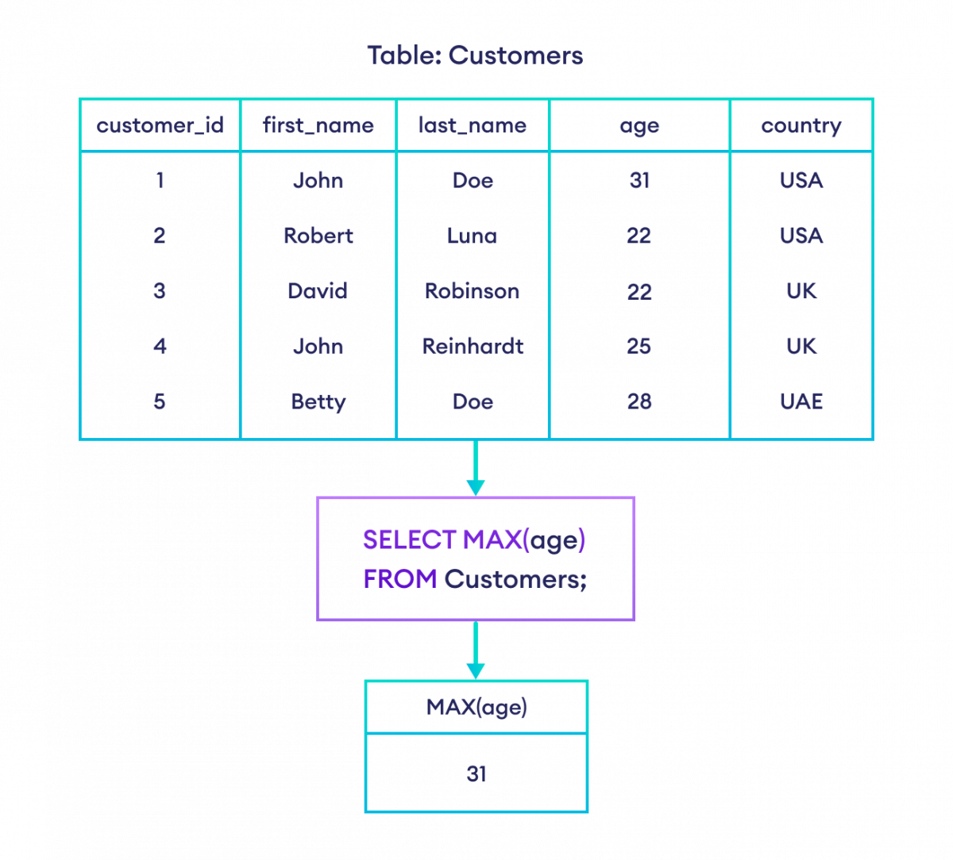
Max()

Slide 16

Min()

Slide 17
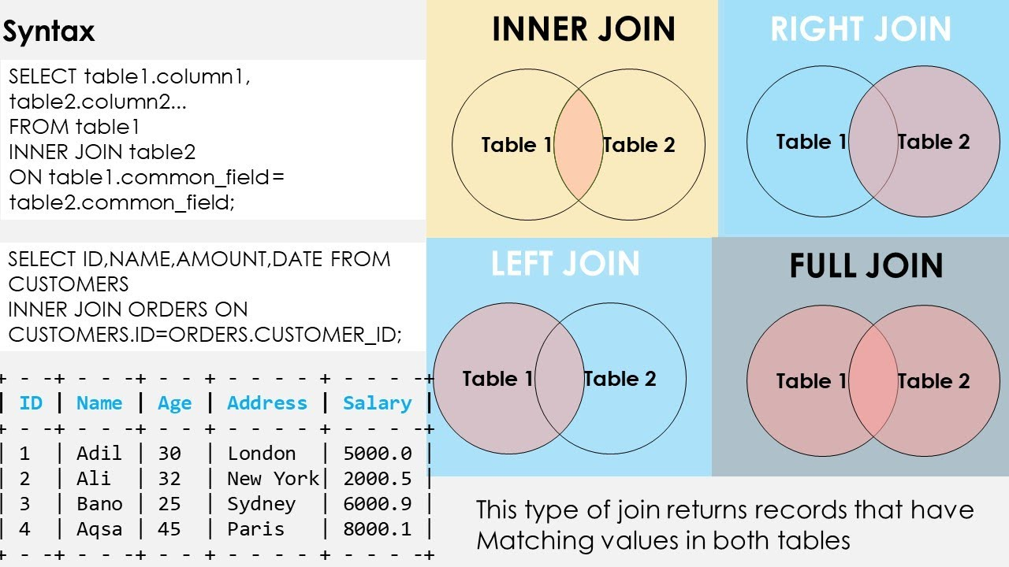
Join

Slide 18
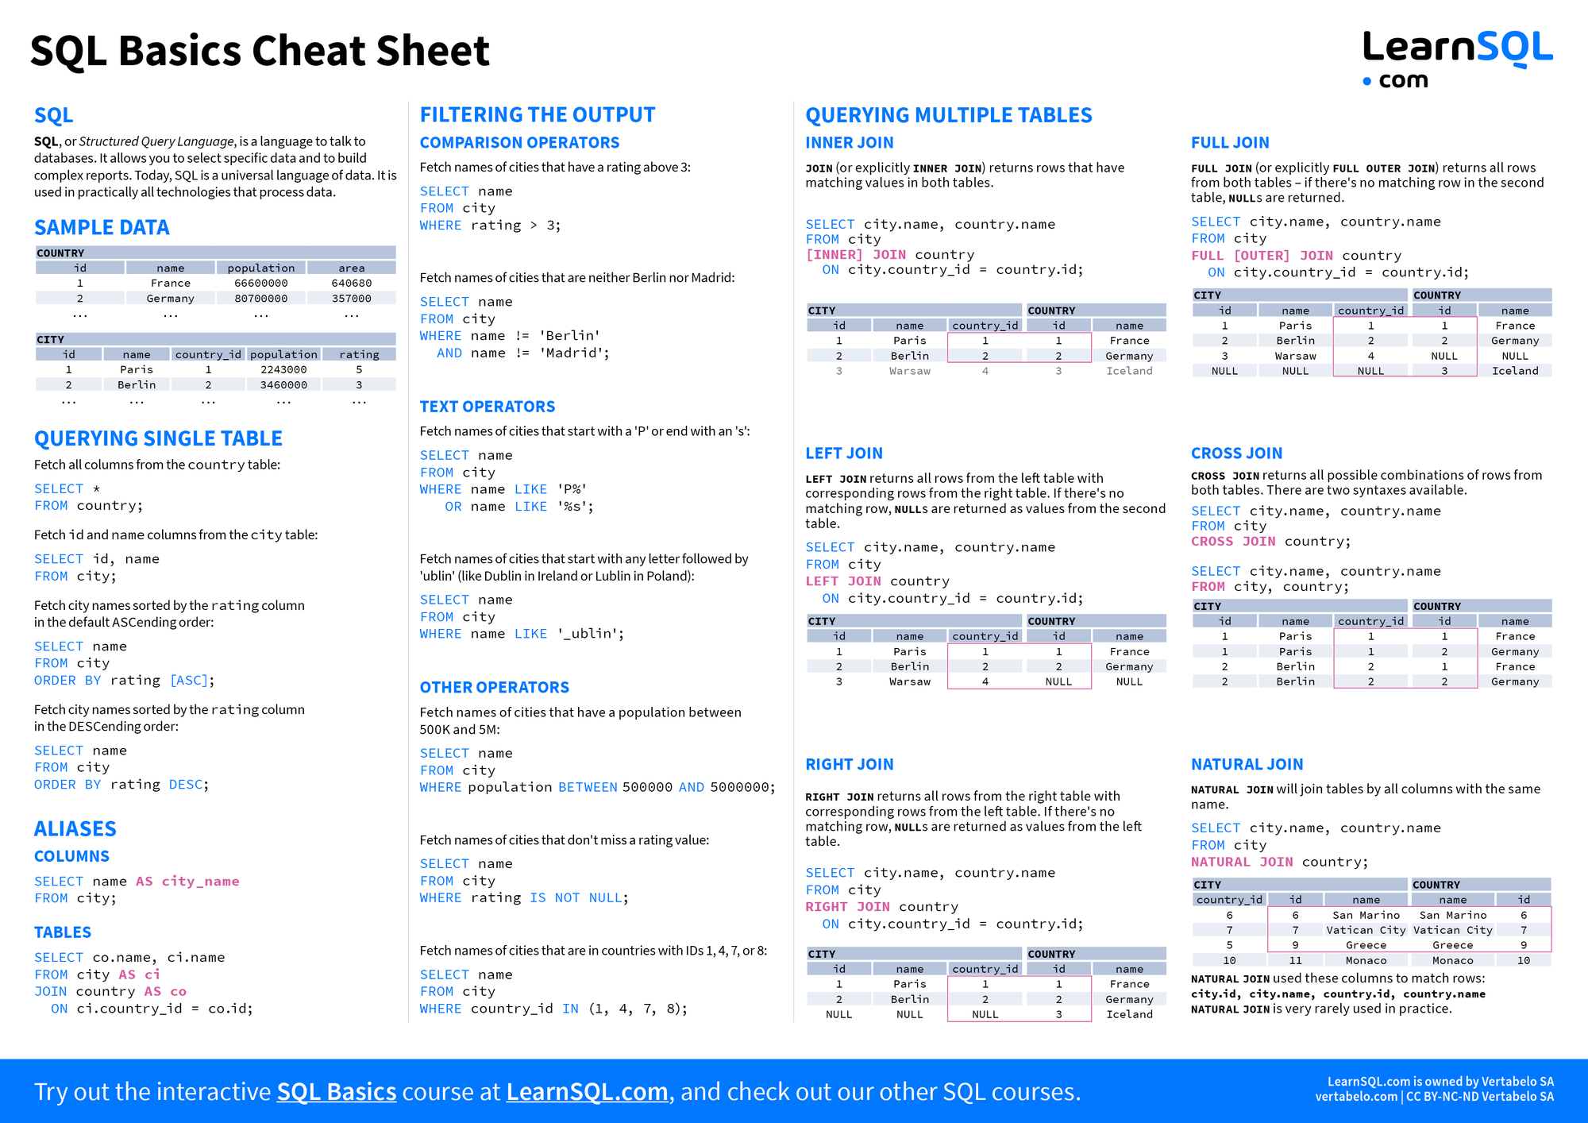


Slide 19
